Slide 1
Build Automation 12th January 2019 #axway

Slide 2
API GATEWAY SETUP BY SCRIPT
Created by Altaf Hossain

Slide 3

Introduction
This PowerPoint will brief about how API gateway setup takes less time by the script in comparison to how much it take while setting it up .

Slide 4
API GATEWAY INSTALLATION
Product Name | Work Efforts
API Gateway | Usuall Work – Accept the end user license Agreement Select the set-up type Select the components which you want to install Specify the directory where the Axway API Gateway will be installed, then for cassandra also
The total efforts which will be required to complete installation of API GATEWAY
will be 20-30 minutes on each node

Slide 5
API gateway Configuration
Product Name | Work Efforts
API Gateway | Usuall Work – 1. Then we will open command prompt in bin folder of API gateway and run the command of managedomain.bat--menu 2. Now firstly we will register the host. 3. After registering the host, we will create a group and a instance related to that. Then we will start startinstance.bat as well. 4. Also the Nodemanager should be started hence we will run the command nodemanager.bat in command prompt in the bin folder of API gateway. 5. Then we will start Cassandra.bat which is in the bin folder of API gateway.
The total time which will be spent in these
tasks will be around 30 minutes on each node

Slide 6
API Analytics INSTALLATION
Product Name | Work Efforts
API Analytics | Usuall Work – Accept the end user license Agreement Select the set-up type Select the Analytics which you want to install from the components Specify the directory where the Axway API Analytics will be installed
The total efforts which will be required to complete installation of API GATEWAY
will be 10-15 minutes on each node

Slide 7
API Manager Configuration
Product Name | Work Efforts
API Manager | Usuall Work – 1. We will open command prompt in bin folder of API gateway and run the command of setup-apimanager 2. Now firstly we need to select the group and instance where API manager is required to be insatlled. 3. Also before staring the installation, the instance should know where the cassandra host are installed and running. 4. The Cassndra and nodemanager as well as instance should be running. 5. Create the api manager user password.
The total time which will be spent in these
tasks will be around 15-20 minutes on each node

Slide 8
What does Script do?
The Script perform all the task in a single go.
You can install Api gateway, create & register nodemanager, create groups & instance.
You can install Cassandra and analytics also with the script.
You can Configure API manager on the required node too.
Start all API gateway, nodemanager, Cassandra & instance services.
All this process will only take only 15 minutes to complete on a node.

Slide 9
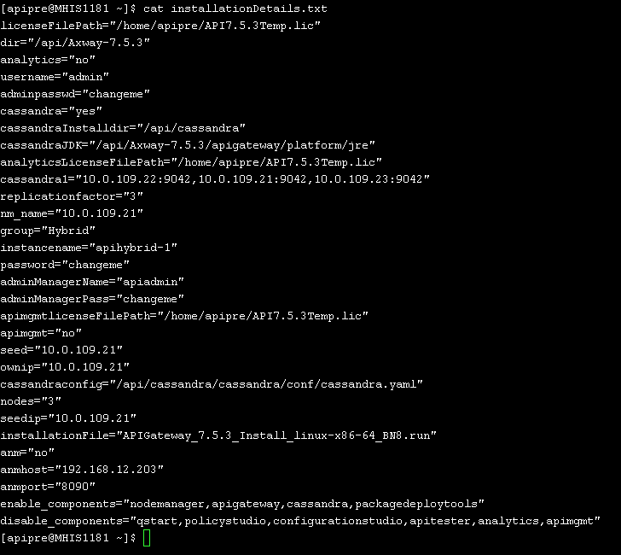
Can I modify the script/componets that I want to install by script ?
Yes the script can be modified
according to the need/requirements
You can select, enable, disable
components that you want on the
platform.
All you need is to configure
the installation file

Slide 10

IS the Script made according to a API version?
No the Script can be used with any API Gateway version like 754 or 762 or any other
The script was designed keeping in mind that it could be
used with any API gateway version.
All the commands are generic and are not used
specific to any version.
Script is already used in the MHIS Hybrid
Installation on PPR and PRD both.

Slide 11
So Decide..!!
Manual installation or the Script usage.
API gate way & components installation– 30 mins
Configure gateway – 30 mins
Install Analytics – 15 mins
Configure API Manager – 20 mins
Total efforts – 1hour 35 mins
Script – 10-15 minutes

Slide 12
Thank you 12th January 2019 #axway

